Slide 1
Baby monitor System
Code review

Slide 2
System Overview
Extensible design allows customizing and future system extensions
RaspiCam
Data(Strings)
PI-Server
XML
Gui Client
RaspiMic
Thermameter
Potential Mobile Client
Potential sensor

Slide 3
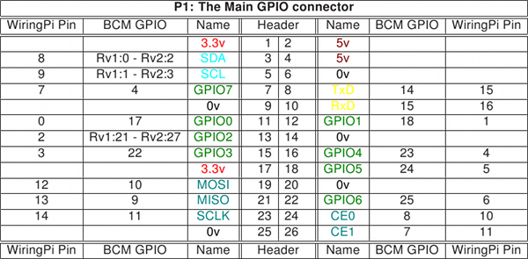
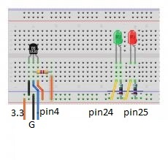
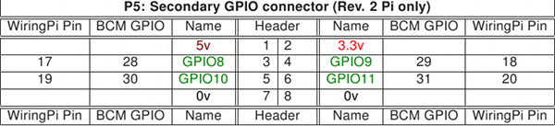
Temperature Sensor

Slide 4
Temperature Sensor
First call
void Setup(void);
wiringpi.pinMode(25,1) #red light wiringpi.pinMode(24,1) #green light …
--------------------------------------------------------
void Led_con(int Temp);
wiringpi.digitalWrite(24,1) #green is on
…
--------------------------------------------------------
*Temp value is between 20°C and 27°C.
Initialize GPIO (sensor and LEDs)
1- Read Temp
2- Detects and reports the status of the system (etc. working normal, problems…)
Normal mode
Reset GPIO (sensor and leds)
Dangerous mode
Last call
void cleanup(void);
wiringpi.digitalWrite(25,0) #red is off wiringpi.digitalWrite(24,0) #green is off
…
--------------------------------------------------------
void Led_con(int Temp);
wiringpi.digitalWrite(25,0) #red is on sleep(1)
wiringpi.digitalWrite(25,1) #red is off
…
--------------------------------------------------------
*Temp value is <40°C or <10°C .
Figure1.1: General view of the Temperature sensor’s functionality

Slide 5
Function Name | Argument | Test | Passed Information/ Action preformed | Expected result | Actual
Led_con | Int Temp | Method | T=Max(40 °C) *Min(10°C) cab be used | Flashing the red led (Void) | Passed
Led_con | Int Temp | Method | T=NR* (x°C) Normal Range(20°C to 27°C) | Green led is on(Void) | Passed
setup | Nothing | Method | Nothing | Flashing the green led(Void) | Passed
cleanup | Nothing | Method | Nothing | Flashing both (green and red) (Void) | Passed
 |  | HTCase one | Touch the sensor with an ice cube ( in a plastic bag) | Temperature readings are decreasing | Passed
 |  | HTCase two | Place a hot object on the sensor | Temperature readings are increasing | Passed

Slide 6
GUI Client class Diagram

Slide 7
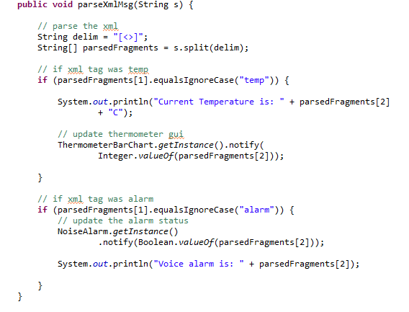
XML parsing and MVC:
Server sends XML messages to mainClient class ( blocked on read msg)
MainClient parses the received msg
Updates the appropriate model classes based on the xml tags
Model notifies the view of the changes
View gets updated accordingly

Slide 8
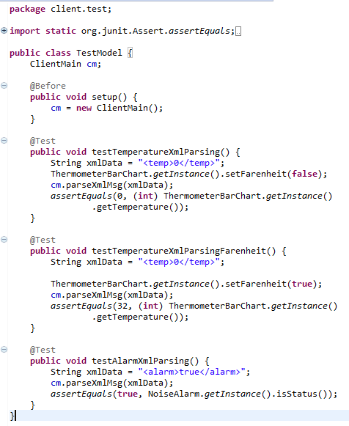
jUnit Test cases:

Slide 9
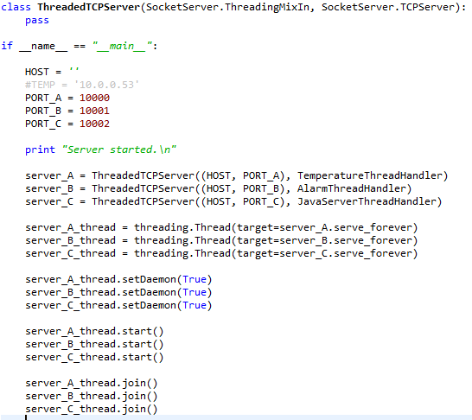
Jython Server

Slide 10
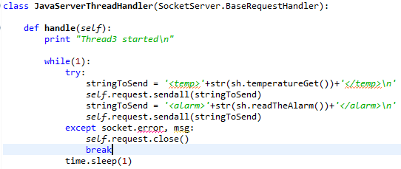
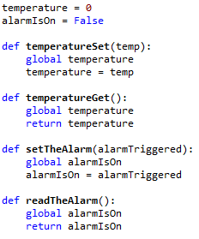
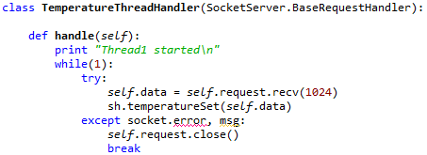
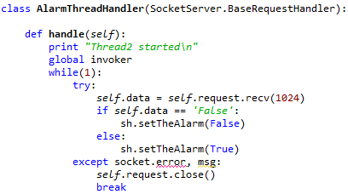

Slide 11
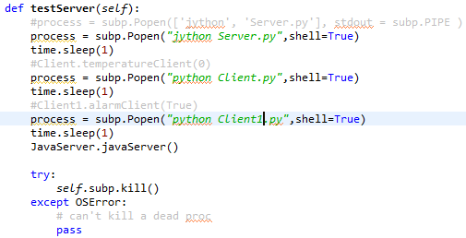
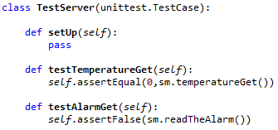
Pyunit Testing

Slide 12
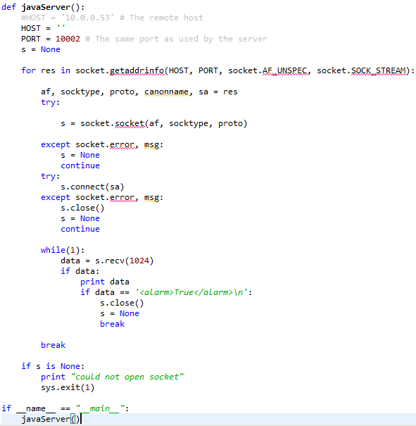
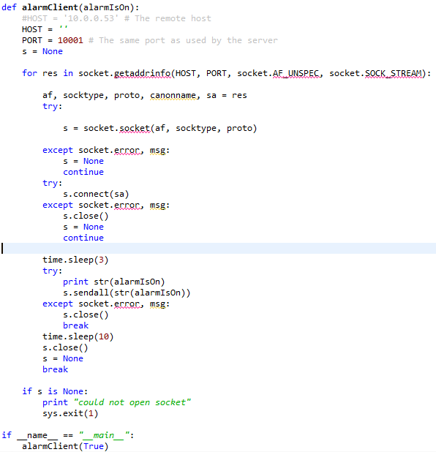

Slide 13
Temperature Sensor

Slide 14
Temperature Sensor
First call
void Setup(void);
wiringpi.pinMode(25,1) #red light wiringpi.pinMode(24,1) #green light …
--------------------------------------------------------
void Led_con(int Temp);
wiringpi.digitalWrite(24,1) #green is on
…
--------------------------------------------------------
*Temp value is between 20°C and 27°C.
Initialize GPIO (sensor and LEDs)
1- Read Temp
2- Detects and reports the status of the system (etc. working normal, problems…)
Normal mode
Reset GPIO (sensor and leds)
Dangerous mode
Last call
void cleanup(void);
wiringpi.digitalWrite(25,0) #red is off wiringpi.digitalWrite(24,0) #green is off
…
--------------------------------------------------------
void Led_con(int Temp);
wiringpi.digitalWrite(25,0) #red is on sleep(1)
wiringpi.digitalWrite(25,1) #red is off
…
--------------------------------------------------------
*Temp value is <40°C or <10°C .
Figure1.1: General view of the Temperature sensor’s functionality

Slide 15
Function Name | Argument | Test | Passed Information/ Action preformed | Expected result | Actual
Led_con | Int Temp | Method | T=Max(40 °C) *Min(10°C) cab be used | Flashing the red led (Void) | Passed
Led_con | Int Temp | Method | T=NR* (x°C) Normal Range(20°C to 27°C) | Green led is on(Void) | Passed
setup | Nothing | Method | Nothing | Flashing the green led(Void) | Passed
cleanup | Nothing | Method | Nothing | Flashing both (green and red) (Void) | Passed
 |  | HTCase one | Touch the sensor with an ice cube ( in a plastic bag) | Temperature readings are decreasing | Passed
 |  | HTCase two | Place a hot object on the sensor | Temperature readings are increasing | Passed
Table 1.1: Details about Temperature sensor's test cases

Slide 16
Raspi Mic
readInput is a file in the Raspberry pi that reads the sound from the microphone and analyses the volume to verify if the sound is high or low and sends the result through TCP/IP to the server.
Raspi
USB
Snowball
Microphone
Sound coming into microphone
readInput

Slide 17
readInput.py
import alsaaudio, time, audioop
# Open the device in nonblocking capture mode. The last argument could
# just as well have been zero for blocking mode. Then we could have
# left out the sleep call in the bottom of the loop
card = 'sysdefault:CARD=Microphone'
inp = alsaaudio.PCM(alsaaudio.PCM_CAPTURE,alsaaudio.PCM_NONBLOCK, card)
# Set attributes: Mono, 8000 Hz, 16 bit little endian samples
inp.setchannels(1)
inp.setrate(16000)
inp.setformat(alsaaudio.PCM_FORMAT_S16_LE)

Slide 18
# The period size controls the internal number of frames per period.
# The significance of this parameter is documented in the ALSA api.
# For our purposes, it is suficcient to know that reads from the device
# will return this many frames. Each frame being 2 bytes long.
# This means that the reads below will return either 320 bytes of data
# or 0 bytes of data. The latter is possible because we are in nonblocking
# mode.
inp.setperiodsize(160)
# Read data from device
l,data = inp.read()
# Return the maximum of the absolute value of all samples in a fragment.
volume = audioop.max(data, 2)

Slide 19
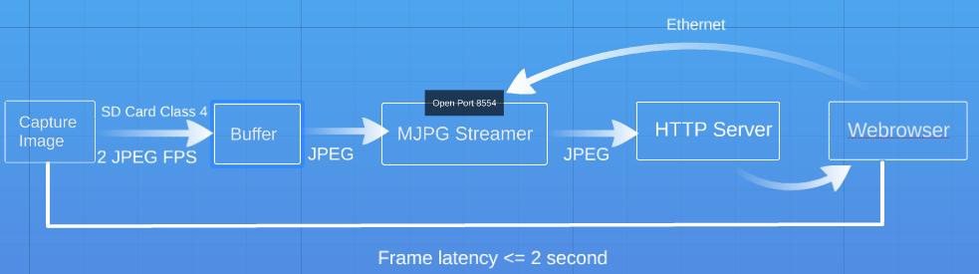
Image Stream top level System Diagram

Slide 20
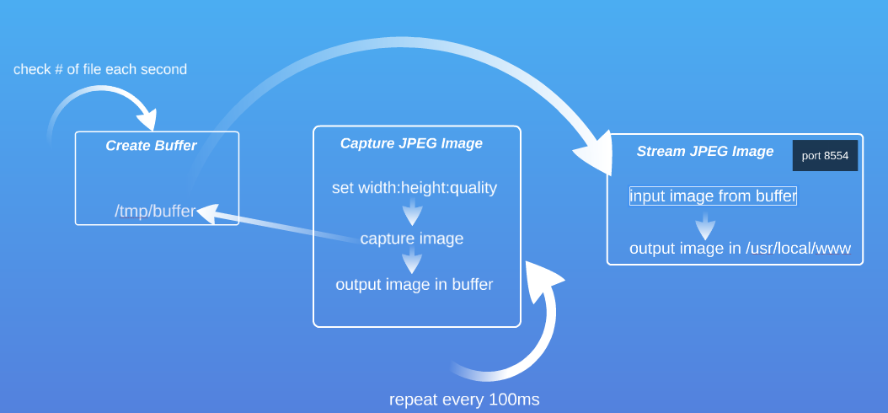
Software Level System Diagram

Slide 21
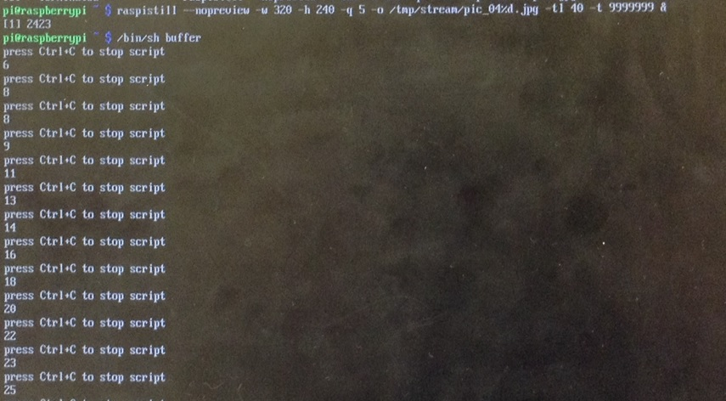
FPS testing

Slide 22
Any Questions/Comments?

Slide 23
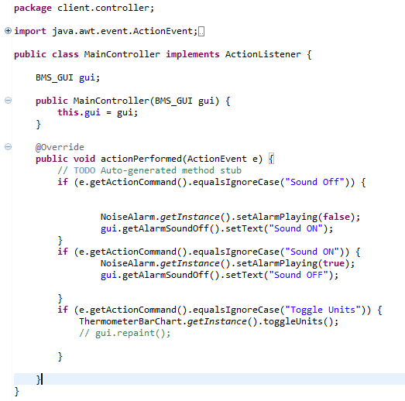
Appendix: controller

Slide 24
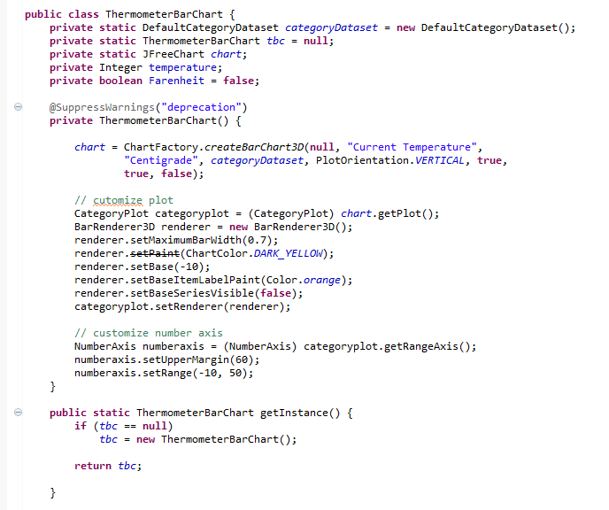
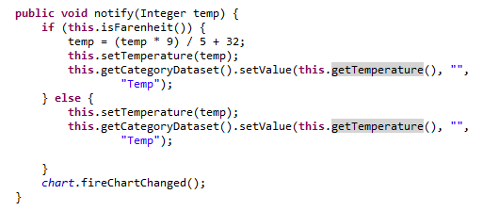
Appendix : BArCHart Model

